Slide 1
Syntax Analysis
Bottom-Up Parsing

Slide 2
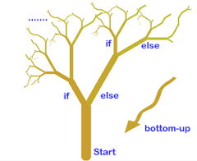
Bottom-Up Parsing
A bottom-up parser creates the parse tree of the given input starting from leaves towards the root.
A bottom-up parser tries to find the right-most derivation of the given input in the reverse order.
  S ⇒ ... ⇒ ω (the right-most derivation of ω)

Slide 3
Bottom-Up Parsing
Bottom-up parsing is also known as shift-reduce parsing because its two main actions; shift and reduce.
  At each shift action, the current symbol in the input string is pushed to a stack.
  At each reduction step, the symbols at the top of the stack will be replaced by the non-terminal at the left side of that production.
  There are also two more actions: accept and error.

Slide 4
Shift-Reduce Parsing
A shift-reduce parser tries to reduce the given input string into the starting symbol.
At each reduction step,
  a substring of the input matched to the right side of a production rule
  And replaced by the non-terminal at the left side of that production rule.
If the substring is chosen correctly, the right most derivation of that string is created in the reverse order.

Slide 5
Shift-Reduce Parsing -- Example
S → aABe input string: abbcde
A → Abc |b aAbcde
B → d aAde aABe
S
S ⇒ aABe ⇒ aAde ⇒ aAbcde ⇒ abbcde
Right Sentential Forms
rm
rm
rm
rm

Slide 6
Shift-Reduce Parsing -- Example
S → aABb input string: aaabb
A → aA | a aaAbb
B → bB | b aAbb ⇓ reduction
aABb
S
S ⇒ aABb ⇒ aAbb ⇒ aaAbb ⇒ aaabb
Right Sentential Forms
How do we know which substring to be replaced at each reduction step?
rm
rm
rm
rm

Slide 7
Handle
A handle of a string is a substring that matches the right side of a production rule.
  But not every substring that matches the right side of a production rule is handle
A handle of a right sentential form γ (≡ αβω) is a production rule A → β and a position of γ
where the string β may be found and replaced by A to produce the previous right-sentential form in a rightmost derivation of γ.
If the grammar is unambiguous, then every right-sentential form of the grammar has exactly one handle.

Slide 8
Handle Pruning
A right-most derivation can be obtained by handle-pruning.
S=γ₀ ⇒ γ₁ ⇒ γ₂ ⇒ ... ⇒ γ_{n-1} ⇒ γ_{n}= ω
input string
Start from γ_{n}, find a handle A_{n}→β_{n} in γ_{n}, and replace β_{n} by A_{n} to get γ_{n-1}.
Then find a handle A_{n-1}→β_{n-1} in γ_{n-1}, and replace β_{n-1} by A_{n-1} to get γ_{n-2}.
Repeat this, until we reach S.
rm
rm
rm
rm
rm

Slide 9
A Shift-Reduce Parser
E → E+T | T Right-Most Derivation of id+id*id
T → T*F | F E ⇒ E+T ⇒ E+T*F ⇒ E+T*id ⇒ E+F*id
F → (E) | id ⇒ E+id*id ⇒ T+id*id ⇒ F+id*id ⇒ id+id*id
Right-Most Sentential Form Reducing Production
id+id*id F → id
F+id*id T → F
T+id*id E → T
E+id*id F → id
E+F*id T → F
E+T*id F → id
E+T*F T → T*F
E+T E → E+T
E
Handles are red and underlined in the right-sentential forms.

Slide 10
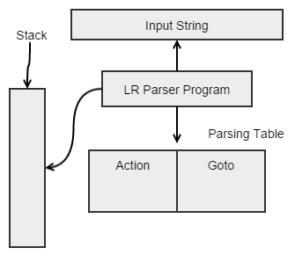
A Shift-Reduce Parser
Shift-reduce parsing attempts to construct a parse tree for an input string beginning at the leaves and working up towards the root.
It is a process of “reducing” a string w to the start symbol S of a grammar

Slide 11
Stack Implementation of Shift-Reduce Parser
There are four possible actions of a shift-reduce parser
  Shift : The next input symbol is shifted onto the top of the stack.
  Reduce: Replace the handle on the top of the stack by the non-terminal.
  Accept: Successful completion of parsing.
  Error: Parser discovers a syntax error, and calls an error recovery routine.
Initial stack just contains only the end-marker $.
The end of the input string is marked by the end-marker $.

Slide 12
A Stack Implementation of A Shift-Reduce Parser
Stack Input Action
$ id+id*id$ shift
$id +id*id$ reduce by F → id
$F +id*id$ reduce by T → F
$T +id*id$ reduce by E → T
$E +id*id$ shift
$E+ id*id$ shift
$E+id *id$ reduce by F → id
$E+F *id$ reduce by T → F
$E+T *id$ shift
$E+T* id$ shift
$E+T*id $ reduce by F → id
$E+T*F $ reduce by T → T*F
$E+T $ reduce by E → E+T
$E $ accept

Slide 13
Conflicts During Shift-Reduce Parsing
There are context-free grammars for which shift-reduce parsers cannot be used.
Stack contents and the next input symbol may not decide action:
  shift/reduce conflict: Whether make a shift operation or a reduction.
  reduce/reduce conflict: The parser cannot decide which of several reductions to make.
If a shift-reduce parser cannot be used for a grammar, that grammar is called as non-LR(k) grammar.
An ambiguous grammar can never be a LR grammar.

Slide 14
Shift-Reduce Parsers
There are two main categories of shift-reduce parsers
Operator-Precedence Parser
  simple, but only a small class of grammars.
LR-Parsers
  covers wide range of grammars.
    SLR – simple LR parser
    LR – most general LR parser
    LALR – intermediate LR parser (lookhead LR parser)
  SLR, LR and LALR work same, only their parsing tables are different.
CFG
LR
LALR
SLR

Slide 15
LR Parsing Algorithm
input
a₁ | ... | a_{i} | ... | a_{n} | $
stack
S_{m}
X_{m}
S_{m-1}
X_{m-1}
.
.
S₁
X₁
S₀
LR Parsing Algorithm
output
Action Table terminals and $ s t four different a actions t e s | Goto Table non-terminal s t each item is a a state number t e s

Slide 16
LR Parsers
The most powerful shift-reduce parsing (yet efficient) is:
LR(k) parsing.
left to right right-most k lookhead
scanning derivation (k is omitted 🡺 it is 1)
LR parsing is attractive because:
  LR parsing is most general non-backtracking shift-reduce parsing.
  The class of grammars that can be parsed using LR method is a proper superset of the class of grammars that can be parsed with predictive parsers.
  An LR-parser can detect a syntactic error as soon as it is possible to do so a left-to-right scan of the input.

Slide 17
A Configuration of LR Parsing Algorithm
A configuration of a LR parsing is:
( S_{o} X₁ S₁ ... X_{m} S_{m}, a_{i} a_{i+1} ... a_{n} $ )
Stack Rest of Input
S_{m} and a_{i} decides the parser action by consulting the parsing action table.
Initial Stack contains just S_{o}

Slide 18
Actions of A LR-Parser
shift s -- shifts the next input symbol and the state s onto the stack
( S_{o} X₁ S₁ ... X_{m} S_{m}, a_{i} a_{i+1} ... a_{n} $ ) 🡺 ( S_{o} X₁ S₁ ... X_{m} S_{m} a_{i} s, a_{i+1} ... a_{n} $ )
reduce A→β
  pop 2*|β| (length of β =r) items from the stack; r states and r symbols.
  then push A and s where s=goto[s_{m-r}, A] entering the state
( S_{o} X₁ S₁ ... X_{m} S_{m}, a_{i} a_{i+1} ... a_{n} $ ) 🡺 ( S_{o} X₁ S₁ ... X_{m-r} S_{m-r} A s, a_{i} ... a_{n} $ )
  Output is the reducing production reduce A→β
Accept – Parsing successfully completed
Error -- Parser detected an error (an empty entry in the action table)

Slide 19
Parsing Tables for Expression Grammar
Action Table
Goto Table
1) E → E+T
2) E → T
3) T → T*F
4) T → F
5) F → (E)
6) F → id
state | id | + | * | ( | ) | $ |  | E | T | F
0 | s5 |  |  | s4 |  |  |  | 1 | 2 | 3
1 |  | s6 |  |  |  | acc
2 |  | r2 | s7 |  | r2 | r2
3 |  | r4 | r4 |  | r4 | r4
4 | s5 |  |  | s4 |  |  |  | 8 | 2 | 3
5 |  | r6 | r6 |  | r6 | r6
6 | s5 |  |  | s4 |  |  |  |  | 9 | 3
7 | s5 |  |  | s4 |  |  |  |  |  | 10
8 |  | s6 |  |  | s11
9 |  | r1 | s7 |  | r1 | r1
10 |  | r3 | r3 |  | r3 | r3
11 |  | r5 | r5 |  | r5 | r5
Si means shift and stack
state i
2. Rj means reduce by production number j
3. Acc means accept
4. Blank error

Slide 20
Actions of A (S)LR-Parser -- Example
stack input action output
0 id*id+id$ shift 5
0id5 *id+id$ reduce by F→id F→id
0F3 *id+id$ reduce by T→F T→F
0T2 *id+id$ shift 7
0T2*7 id+id$ shift 5
0T2*7id5 +id$ reduce by F→id F→id
0T2*7F10 +id$ reduce by T→T*F T→T*F
0T2 +id$ reduce by E→T E→T
0E1 +id$ shift 6
0E1+6 id$ shift 5
0E1+6id5 $ reduce by F→id F→id
0E1+6F3 $ reduce by T→F T→F
0E1+6T9 $ reduce by E→E+T E→E+T
0E1 $ accept

Slide 21
Constructing SLR Parsing Tables – LR(0) Item
An LR(0) item of a grammar G is a production of G a dot at the some position of the right side.
Ex: A → aBb Possible LR(0) Items: A → .aBb
(four different possibility) A → a.Bb
A → aB.b
A → aBb.
Sets of LR(0) items will be the states of action and goto table.
A collection of sets of LR(0) items (the canonical LR(0) collection) is the basis for constructing SLR parsers.
Augmented Grammar:
G′ is G with a new production rule S′→S where S′ is the new starting symbol.

Slide 22
The Closure Operation
Closure
  If I is a set of LR(0) items for a grammar G, then closure(I) is the set of LR(0) items constructed from I by the two rules:
    Initially, every LR(0) item in I is added to closure(I).
    If A → α.Bβ is in closure(I) and B→γ is a production rule of G; then B→.γ will be in the closure(I).
  We will apply this rule until no more new LR(0) items can be added to closure(I).

Slide 23
The Closure Operation -- Example
E’ → E closure({E’ → .E}) =
E → E+T { E’ → .E
E → T E → .E+T
T → T*F E → .T
T → F T → .T*F
F → (E) T → .F
F → id F → .(E)
F → .id }

Slide 24
Construction of The Canonical LR(0) Collection
To create the SLR parsing tables for a grammar G, we will create the canonical LR(0) collection of the grammar G′.
Algorithm:
  C is { closure({S’→.S}) }
  repeat the followings until no more set of LR(0) items can be added to C.
    for each I in C and each grammar symbol X
      if goto(I, X) is not empty and not in C
        add goto(I,X) to C
goto function is a DFA on the sets in C.

Slide 25
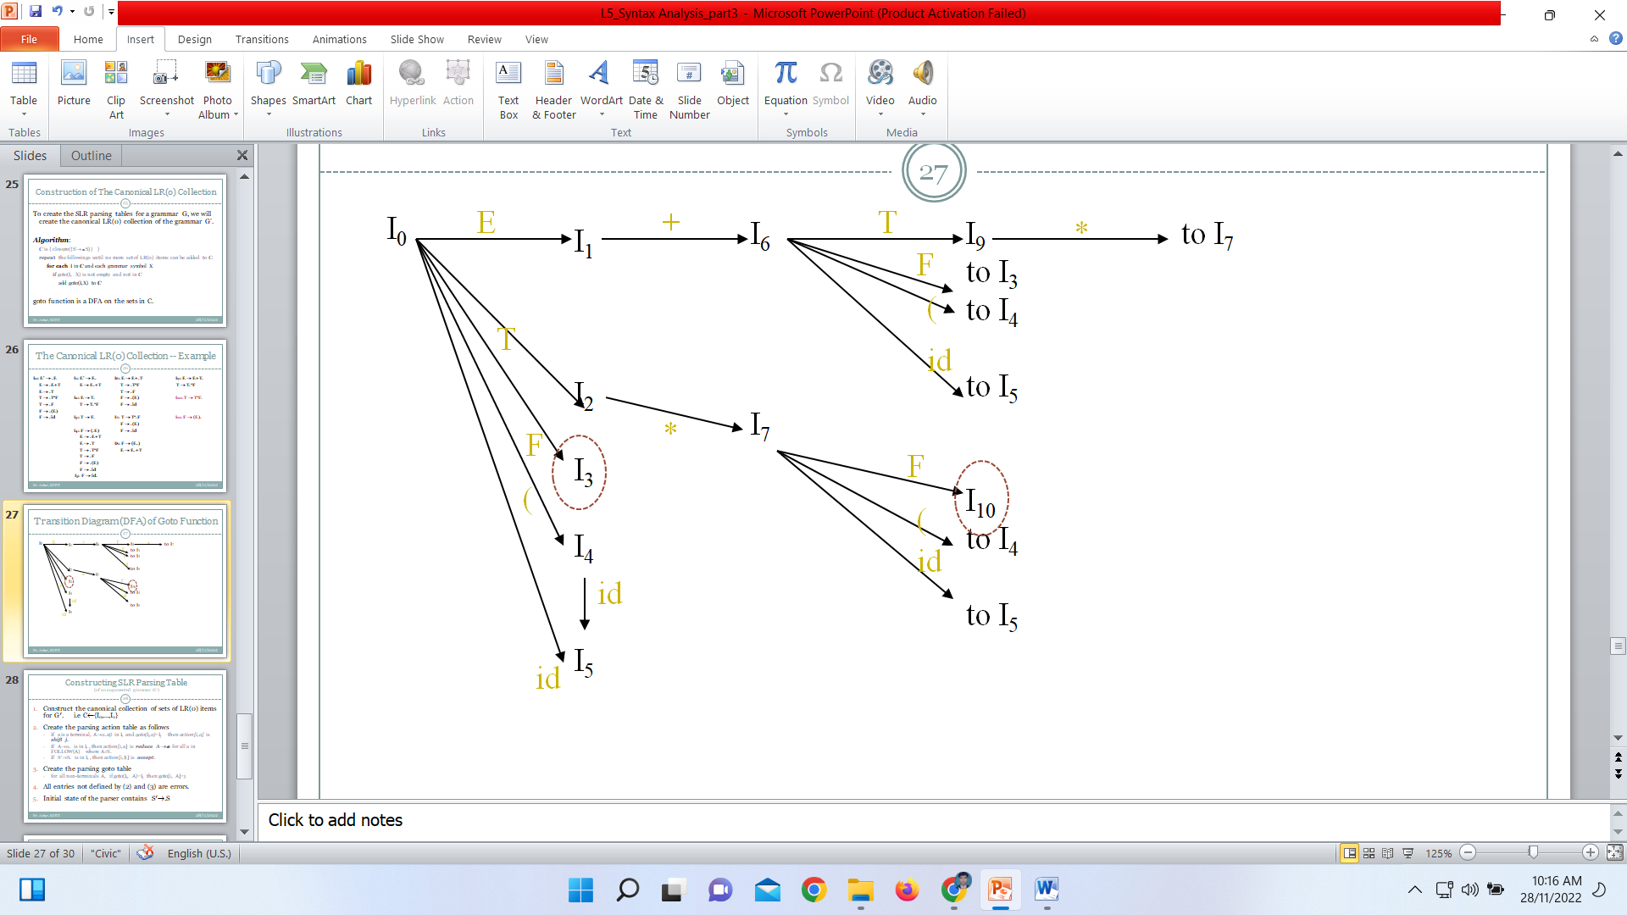
The Canonical LR(0) Collection -- Example
I₀: E’ → .E I₁: E’ → E. I₆: E → E+.T I₉: E → E+T.
E → .E+T E → E.+T T → .T*F T → T.*F
E → .T T → .F
T → .T*F I₂: E → T. F → .(E) I₁₀: T → T*F.
T → .F T → T.*F F → .id
F → .(E)
F → .id I₃: T → F. I₇: T → T*.F I₁₁: F → (E).
F → .(E)
I₄: F → (.E) F → .id
E → .E+T
E → .T I₈: F → (E.)
T → .T*F E → E.+T
T → .F
F → .(E)
F → .id
I₅: F → id.

Slide 26
Transition Diagram (DFA) of Goto Function
I₀
E
I₁
I₂
I₃
I₄
I₅
+
I₆
I₇
T
I₉
to I₃
to I₄
to I₅
I₁₀
to I₄
to I₅
*
to I₇
F
(
T
id
F
*
F
(
(
id
id
id
See text book for complete DFA

Slide 27
Constructing SLR Parsing Table
(of an augumented grammar G′)
Construct the canonical collection of sets of LR(0) items for G′. i.e C←{I₀,...,I_{n}}
Create the parsing action table as follows
  If a is a terminal, A→α.aβ in I_{i} and goto(I_{i},a)=I_{j} then action[i,a] is shift j.
  If A→α. is in I_{i} , then action[i,a] is reduce A→α for all a in FOLLOW(A) where A≠S′.
  If S′→S. is in I_{i} , then action[i,$] is accept.
Create the parsing goto table
  for all non-terminals A, if goto(I_{i}, A)=I_{j} then goto[i, A]=j
All entries not defined by (2) and (3) are errors.
Initial state of the parser contains S′→.S

Slide 28
Parsing Tables of Expression Grammar
Goto Table
Action Table
state | id | + | * | ( | ) | $ |  | E | T | F
0 | s5 |  |  | s4 |  |  |  | 1 | 2 | 3
1 |  | s6 |  |  |  | acc
2 |  | r2 | s7 |  | r2 | r2
3 |  | r4 | r4 |  | r4 | r4
4 | s5 |  |  | s4 |  |  |  | 8 | 2 | 3
5 |  | r6 | r6 |  | r6 | r6
6 | s5 |  |  | s4 |  |  |  |  | 9 | 3
7 | s5 |  |  | s4 |  |  |  |  |  | 10
8 |  | s6 |  |  | s11
9 |  | r1 | s7 |  | r1 | r1
10 |  | r3 | r3 |  | r3 | r3
11 |  | r5 | r5 |  | r5 | r5

Slide 29
Thank You

